Slide 1
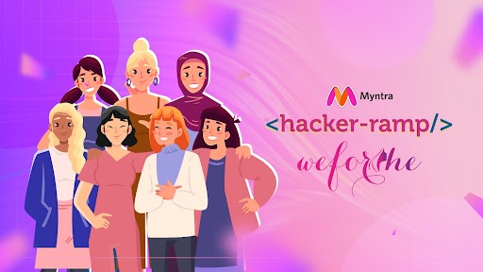
Team Name : PipInstall
Team Details: Khushi Garg-IIIT Pune Aastha Joshi- GEHU Anngha C Panigrahi-IIIT Bh
I wish I could have this kalamkari incorporated into my hijab
All these designs but nowhere to display them

Slide 2
Solution: Bridging Tradition with Innovation
A Digital Platform for Designers
In an era where Gen Z often feels disconnected from traditional cultural heritage, there is a growing need to create innovative solutions that bridge this gap. Local textile traditions, such as Bandhani from Gujarat, Kalamkari from Andhra Pradesh, and Phulkari from Punjab, are rich with history and craftsmanship but risk becoming obsolete as modern fashion trends evolve.
PROPOSAL: An interactive digital platform that enables designers to showcase their work and play an AI-driven trend game to generate new prints and designs inspired by traditional local textiles.
DESIGN-VERSE
TrendWeave- Showcase Their Own Prints Fashion Roulette-AI driven Trend Game
Outfit Challenges -Where designers may compete

Slide 3
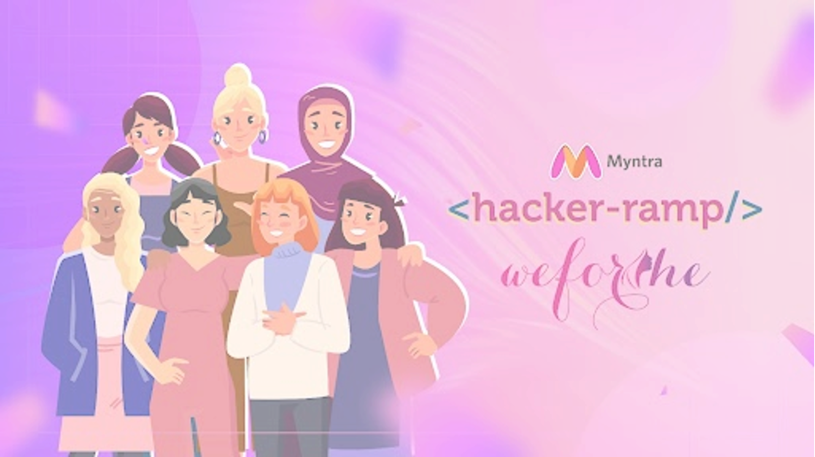
OBJECTIVE
FEATURES
GOALS
1. *Designer Profiles*: Each designer can create a profile, add their bio, and showcase their portfolio of prints and designs.
2. *Print Upload & Display*: A section for designers to upload their own prints, categorized by local textile inspiration.
3. *AI Trend Game*: An interactive game where AI generates new print designs based on traditional textiles, which designers can use as inspiration or adapt into their own creations.
4. *Outfit Challenges*: Themed challenges where designers can submit their fashion looks. These challenges will have themes related to seasons, events, or specific cultural elements.
5. *Homepage Features*: A rotating showcase of top designs and prints, with special features for designers who win the outfit challenges or receive high engagement.
To create an engaging online platform for designers where they can:
1. *Showcase Their Own Prints*: Designers can upload and display their own textile designs inspired by local traditions (e.g., Bandhani).
2. *Trend Game with AI*: Designers can participate in a trend game where an AI generates new print designs based on local textiles. These AI-generated designs aim to modernize traditional patterns and make them appealing to Gen Z.
3. *Outfit Challenges*: Designers can submit their fashion looks based on specific themes. The best submissions will be featured on the homepage, providing exposure and engagement for the designers.
1. *Cultural Preservation*: Promote the use of traditional textiles and patterns in modern fashion, preserving cultural heritage.
2. *Engagement & Community Building*: Create a vibrant community of designers who can interact, collaborate, and compete in a friendly environment.
3. *Exposure for Designers*: Provide a platform for emerging designers to gain recognition and grow their audience.
4. *Innovation in Fashion*: Encourage the fusion of traditional and contemporary fashion through AI-generated designs and creative challenges.

Slide 4
TARGET AUDIENCE
SUCCESS METRIC
TECH STACK
1. *User Engagement*: Number of active designers, print uploads, and challenge submissions.
2. *Platform Traffic*: Website visits and time spent on the platform.
3. *Social Media Buzz*: Mentions, shares, and engagement on social media platforms.
4. *Designer Recognition*: Number of designers getting featured on the homepage and their subsequent growth in followers and opportunities.
1. *Emerging and Established Designers*: Looking for innovative ways to showcase their work and gain exposure.
2. *Gen Z Fashion Enthusiasts*: Interested in unique, culturally rich fashion trends.
3. *Fashion Industry Stakeholders*: Including brands, influencers, and consumers looking for fresh and innovative designs.
Frontend: React JS, ExpressJS
Backend: FastAPI, Python, TypeScript, Javascript, Node JS
Database: MongoDB
Hosting: GCP/AWS

Slide 5
Solution:-

Slide 6
Benefits

Slide 7
Solution

Slide 8

Problem Statement:-
Only 15% of content consumed by Gen Z includes traditional Indian cultural elements, compared to over 50% of content preferred by older generations.
The Fashion Design Council of India (FDCI) notes that 70% of fashion trends followed by Gen Z are influenced by Western and contemporary designs, leaving traditional prints and fabrics with less than 30% influence.
Media consumption patterns show that Gen Z prefers digital content (social media, streaming platforms), which seldom features traditional crafts and textiles
A survey conducted by the Craft Revival Trust (2019) found that only 35% of urban Indian youth could correctly identify more than three traditional textiles specific to Indian states
Trend Generation
Solution
Engagement on a shopping platform

